Slide 1
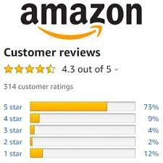
Analysis Of Amazon
Cell Phone
Reviews Using IBM Cloud
SMARTINTERNZ
Guided Project
By
Lokesh kumar. P -18MIS0194
Rohit kumar.KA -18MIS0166
Mugunthan.B -18MIS0173
Munagala Lakshmi Srikanta - 18BSW0022

Slide 2
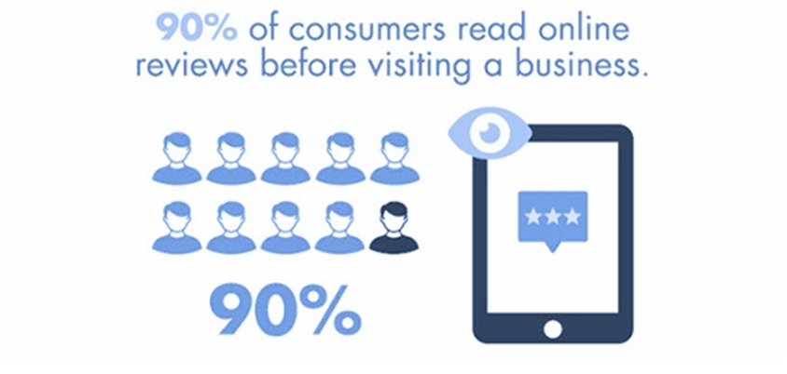
PROBLEM STATEMENT
Mobile phones have revolutionized the way we purchase products online, making all the information available at our fingertips. As the access to information becomes easier, more and more consumers will seek product information from other consumers apart from the information provided by the seller. Reviews and ratings submitted by consumers are examples of such of type of information and they have already become an integral part of customer’s buying-decision process. The review and ratings platform provided by e-Commerce players creates transparent system for consumers to take informed decision and feel confident about it.

Slide 3
SOLUTION
It is difficult to read all the feedback for a particular item especially
for the popular items with many comments. In this project, we will attempt to understand the factors that contribute to classifying reviews as positive or negative.
We will be using Natural language processing to analyze the sentiment (positive or a negative) of the given review. After building our model, we saved the model and bag of count vector file which we will be loading it in flask to predict the output on the UI page. A sample web application is integrated to the model built which is called as flask. Flask is an API of Python that allows us to build up web-applications.

Slide 4
PROCESS FLOW
Data Collection.
Collect the dataset or Create the dataset
Text Preprocessing.
Import the Libraries.
Importing the dataset.
Remove Punctuations
Convert each word into a lower case.
Stemming.
Splitting Data into Train and Test.
Model Building
Import the model building Libraries
Initializing the model
Adding Input Layer
Adding Hidden Layer
Adding Output Layer
Configure the Learning Process
Training and testing the model
Optimize the Model
Save the Model
Application Building
Create an HTML file
Build a Python Code

Slide 5
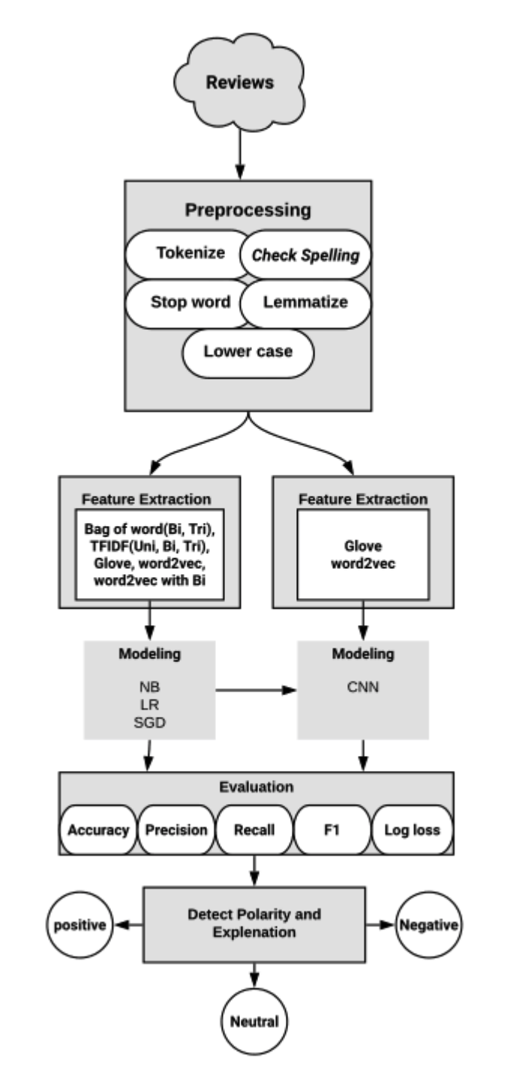
FLOWCHART

Slide 6
LIMITATIONS AND
FUTURESCOPE
In this study, we implemented four types of algorithms with a variety of feature extraction. Some algorithms that remain to be applied in future work include LSTM, KNN, and Maximum entropy. Then, we will compare the result to the result we performed in this project. Our research has some limitations: NLP is relatively a new topic, and highly advanced; hence, it needs a lot of research to understand the field and how it works. Furthermore, we faced some problems with computer memory causing experiments to be highly time consuming. We also used Google Colab to increase the performance, but it did not give us the expected speed.

Slide 7
UI DESIGNED

Slide 8
THANK YOU

